Slide 1
GL 45 (R) – Bracketing and matrixing designs for stability testing of new veterinary drug substances and medicinal products

Slide 2
Table of contents
Scope
Bracketing
  Design factors
  Example of a bracketing design
Matrixing
  Design factors
  Examples of matrixing designs

Slide 3
1. Scope

Slide 4
Scope
The application of bracketing and matrixing to stability studies conducted in accordance with VICH GL3 - Stability testing of new veterinary drug substances and medicinal products.
Design factors: variables to be evaluated in a study design for their effect on product stability:
Strength
Container closure sizes
Fill volume

Slide 5
Scope
Full study : samples for every combination of all design factors are tested at all time points
Reduced design:
  samples for every factor combination are not tested at all time points
  Able to adequately predict the retest period or shelf-life
  Applicable to most types of new veterinary medicinal products
  Not applicable or limited for new veterinary drug substances

Slide 6
2. Bracketing

Slide 7
Bracketing
Bracketing principle
= design of a stability schedule such that only samples on the extremes of certain design factors are tested at all time points as in a full design.
Assumes that the stability of any intermediate levels is represented by the stability of the extremes tested.

Slide 8
Bracketing
Bracketing design factors
Strength
Applicable to studies with multiple strengths of identical or closely related formulations only (unless justified)
Container closure size and/or fill
Applicable to studies of the same container closure system where either container size or fill varies while the other factors remain constant.
Selection of the extremes : comparison of various characteristics of the container closure system that may affect the product stability
  (wall thickness, closure geometry, surface area to volume ratio, headspace to volume ratio, water vapour permeation rate or oxygen permeation rate).

Slide 9
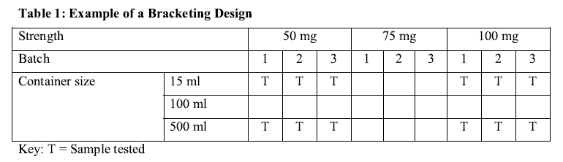
Bracketing
Bracketing design example

Slide 10
3. Matrixing

Slide 11
Matrixing
Matrixing principle
= design of a stability schedule such that a selected subset of the total number of possible samples for all factor combinations.
Assumes that the stability of each subset of samples tested represents the stability of all samples at a given time point.

Slide 12
Matrixing
Identification of differences in the samples for the same product (different batches, different strengths, different sizes of the same container closure system, different container closure systems in some cases)
Consideration of knowledge of data variability, expected stability of the medicinal product, availability of supporting data, stability differences in the medicinal product within a factor or among factors and/or number of factor combination in the study.

Slide 13
Matrixing
Matrixing design factors
Applicable to strengths with identical or closely related formulations, batches made by using the same process/equipment, container sizes and/or fill volumes in the same container closure system.

Slide 14
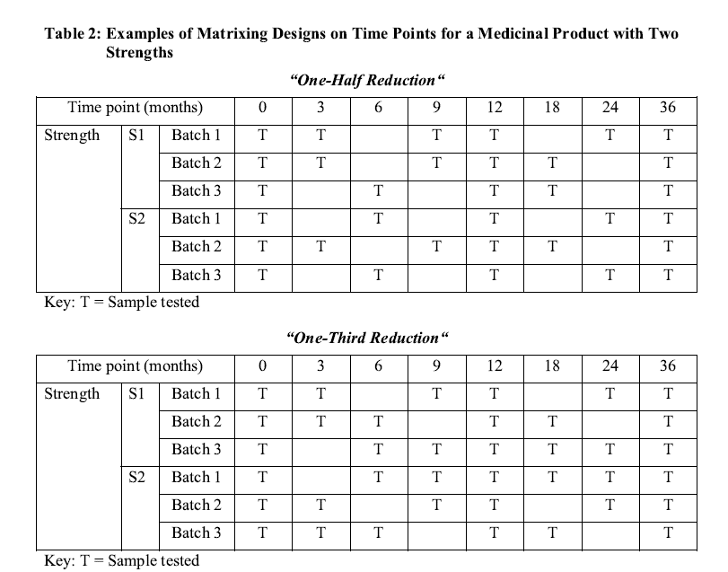
Matrixing
Matrixing design example

Slide 15
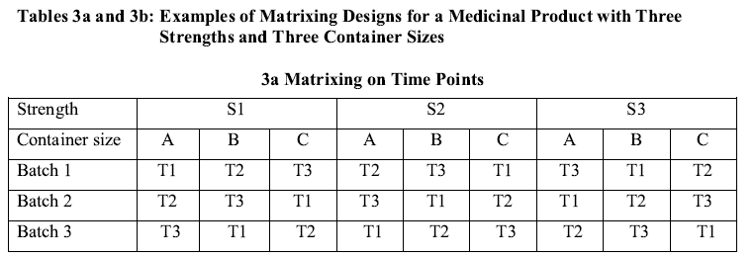
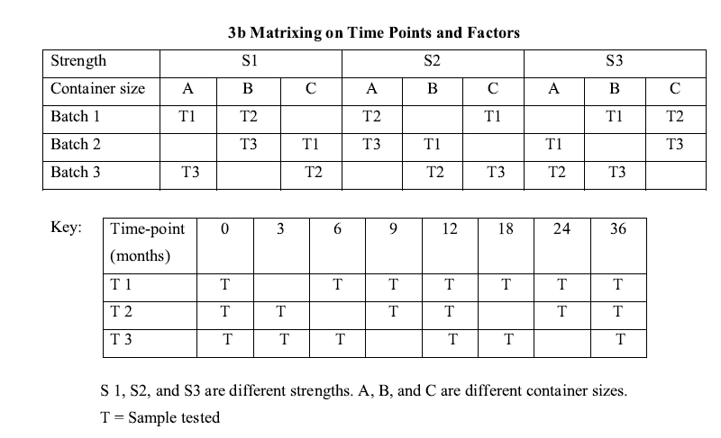
Matrixing
Matrixing design example (continued)

